Slide 1
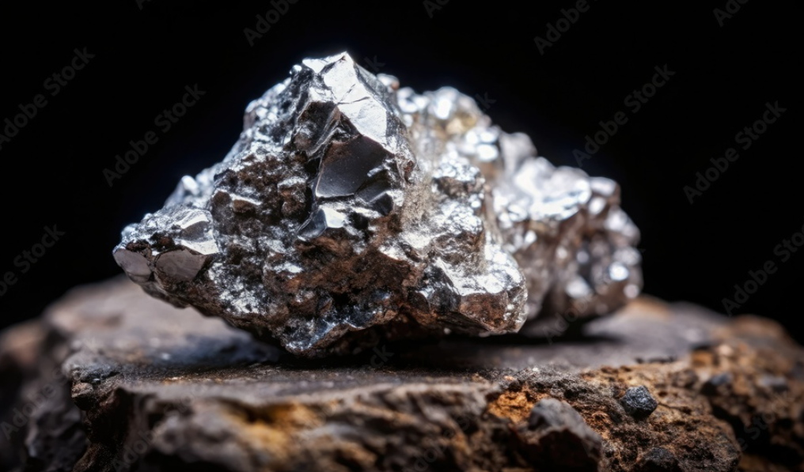
Silver Image Detection
CNNs vs. Vision Transformers
Brent Knopp, Lacey Bowden,
Josh Gillium, and Sebastian Vera

Slide 2
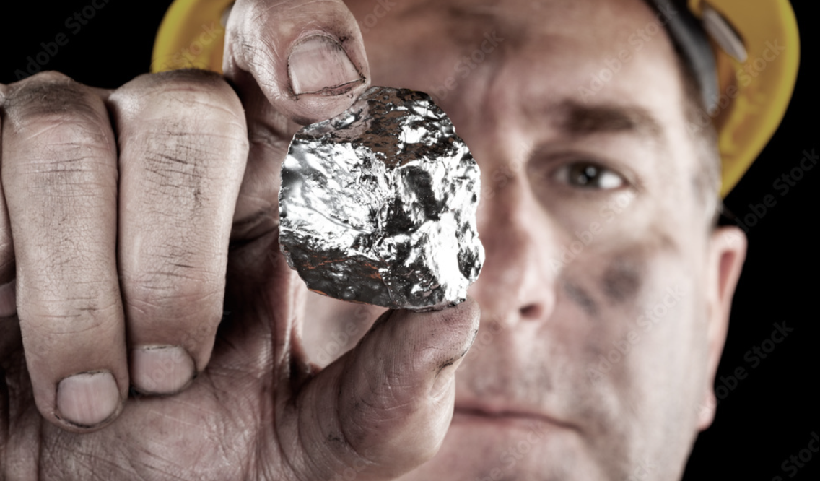
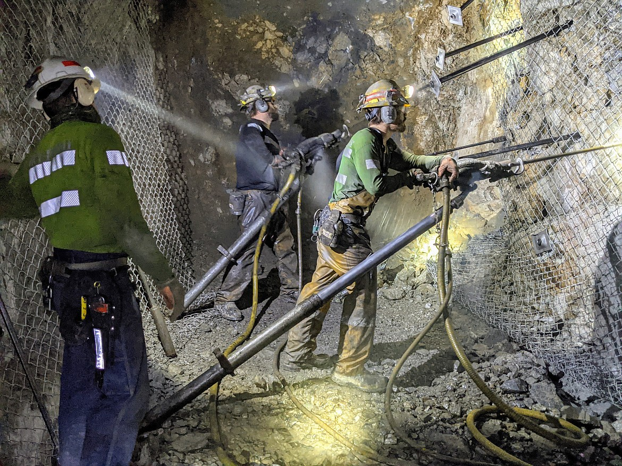
Contents
Background/Motivation
Data Collection
Image Dataset
Machine Learning Models
Comparison Results
Project Future Work
Q&A

Slide 3
Background

Slide 4
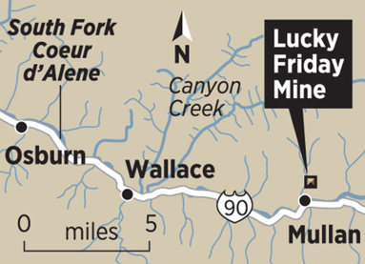
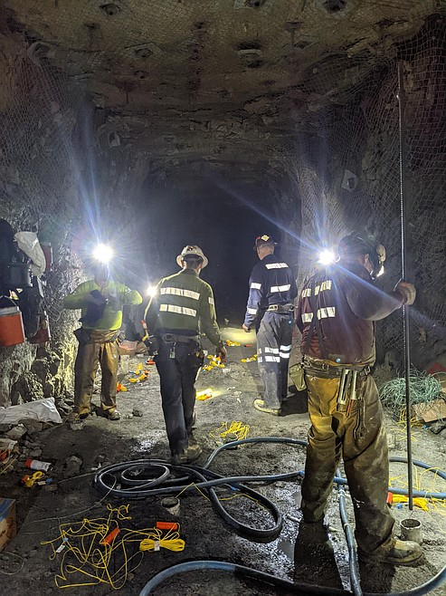
Background
Traditional Mineral Identification
Manual inspection by geologists
Laboratory analysis (X-ray Fluorescence , chemical assays)
Limitations:
Time-consuming
Expensive
Not real-time

Slide 5
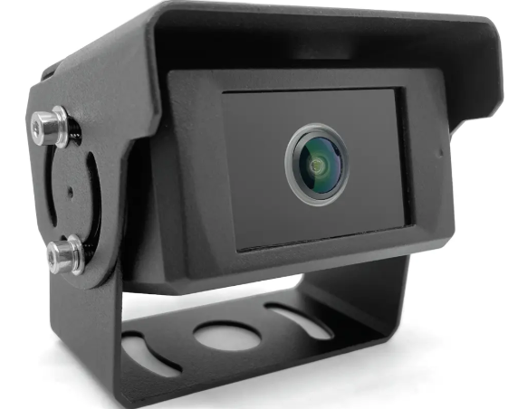

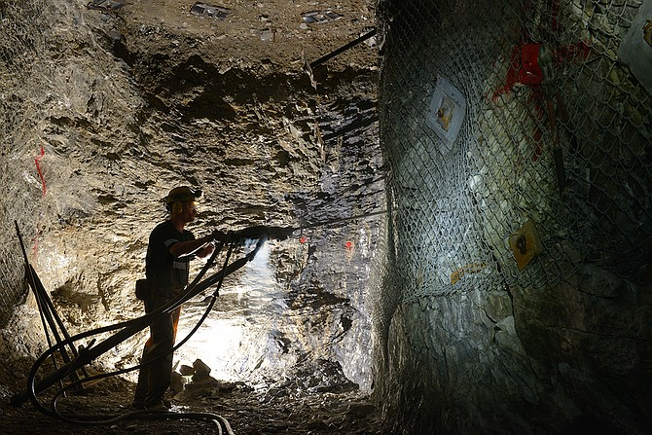
Motivation
Build Complete Machine Vision Pipline To Create Real Time Silver Detection
Can machine vision be used to accurately detect instances of silver?
Does a Convolutional Neural Network (CNN) or a Vision Transformer (ViT) perform better on a relatively small image set, where a majority of the non-silver class consists of minerals similar in look to silver?

Slide 6
Data Collection

Slide 7
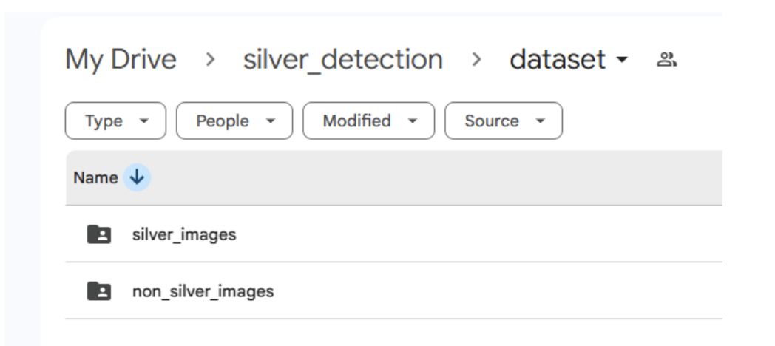
Data Collection
Python script downloaded Silver images from Github
Dataset stored in a GitHub repository with linked cloud storage (Google Drive)
CSV
Silver & Non-Silver Classes

Slide 8
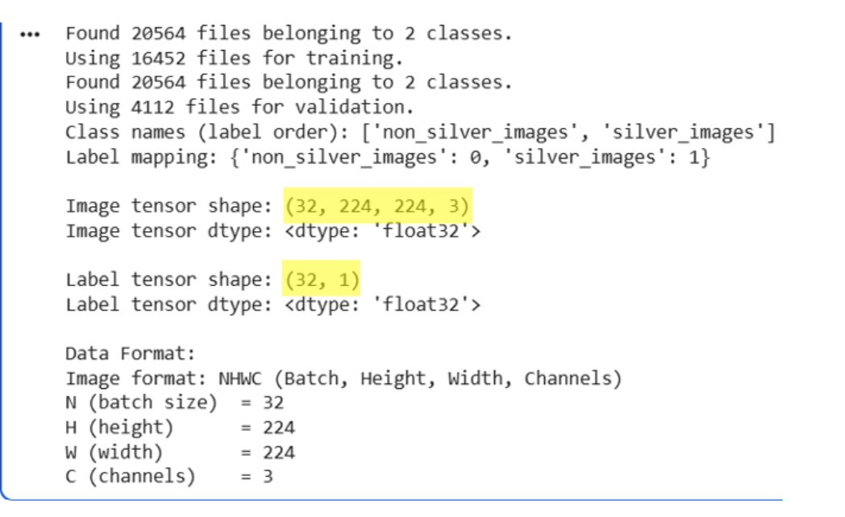
Data Preparation
Silver class must contain only correct and valid mineral images
Corrupted images removed from dataset
Using metadata "drop" identifier
Data Formating
Stored as 4-Dimensional Tensor for Keras training

Slide 9
Image dataset

Slide 10
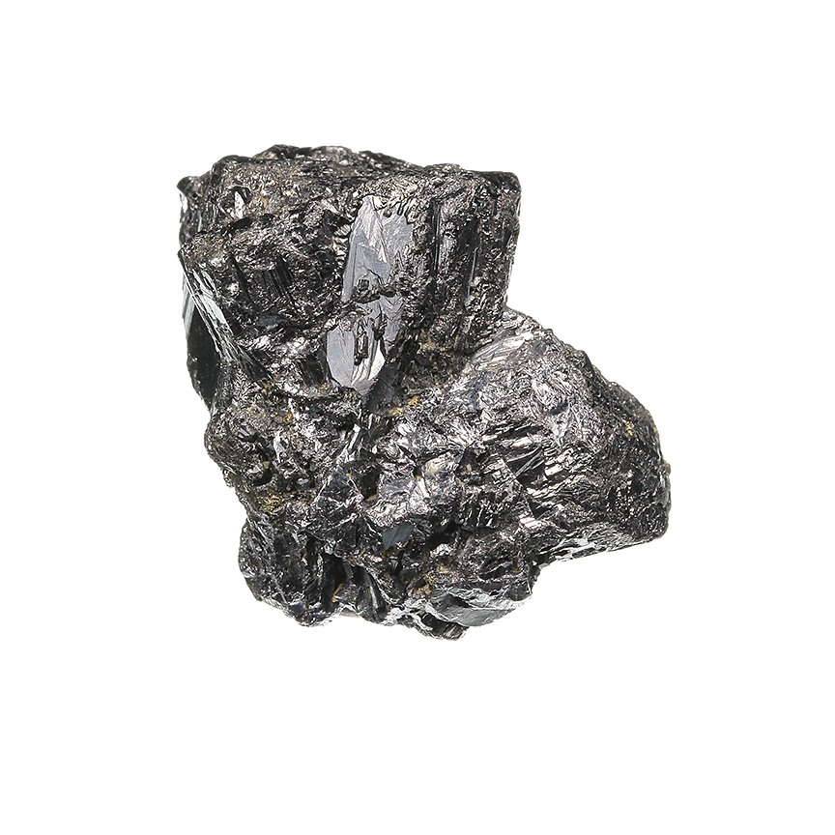
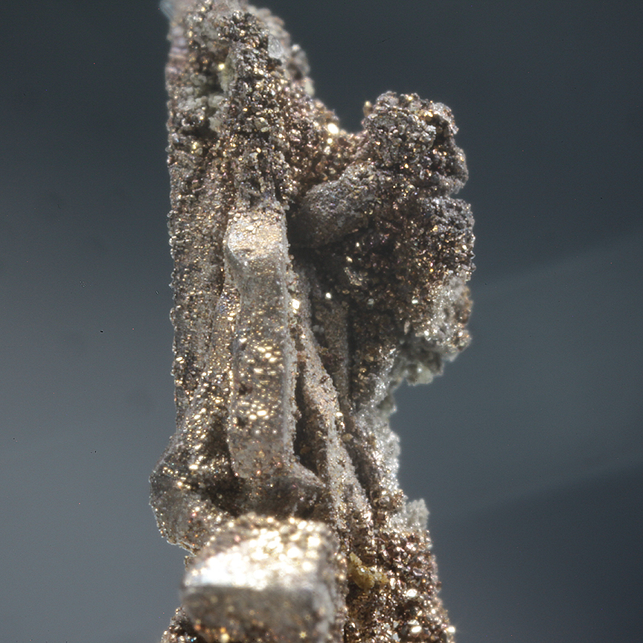
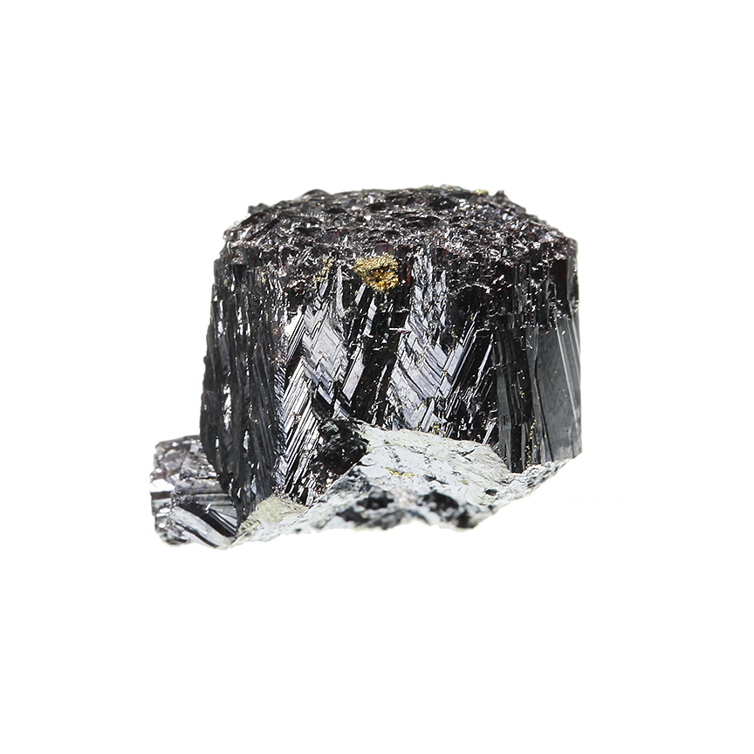
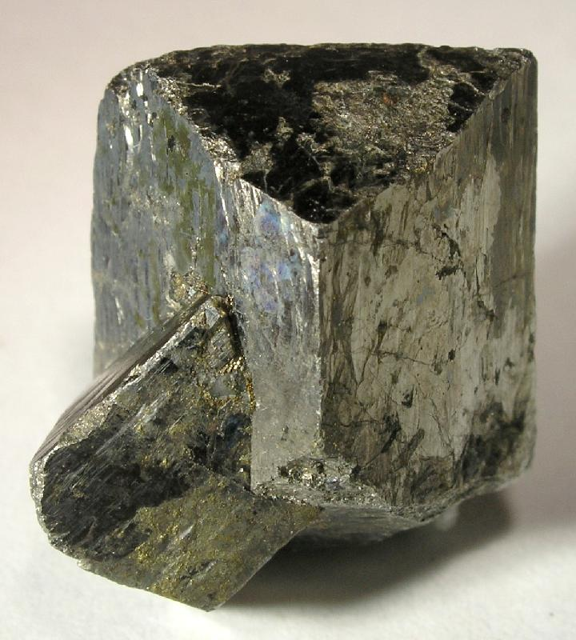
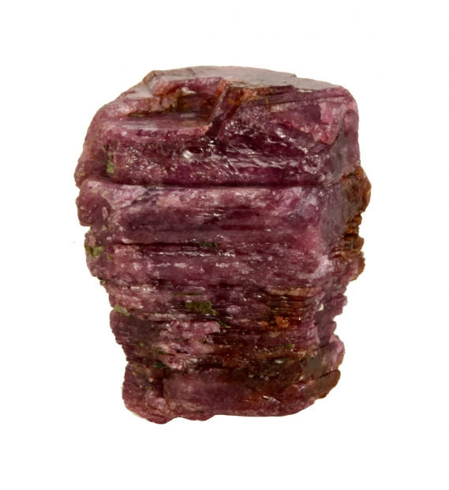
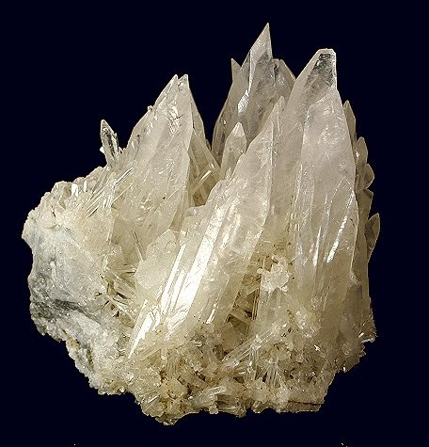
Image dataset: Retrieval
Binary classification dataset:
Silver
Non-silver
JPEG images from Mindat database
Used automated Python scripts for image retrieval
Original dataset size
Total images = 20,564
Silver images = 3,869
Non-silver images = 16,695

Slide 11
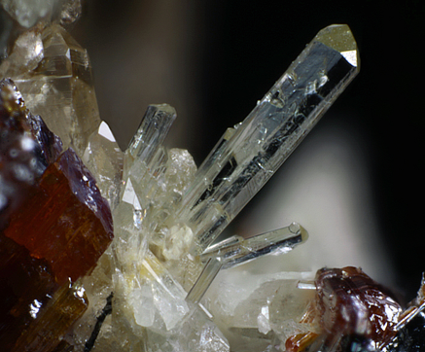
Image dataset: Composition
Silver class has 10 silver bearing minerals
Non-silver class has hard negatives and soft negatives
8 hard negatives
70% hard negatives
30% soft negatives

Slide 12
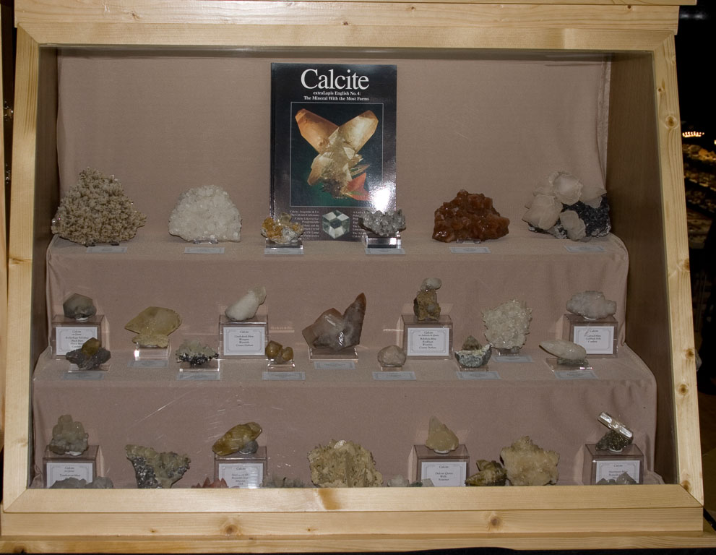
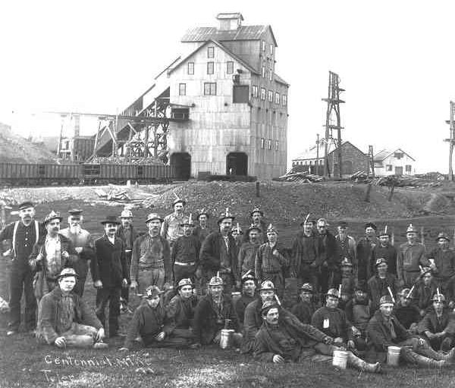
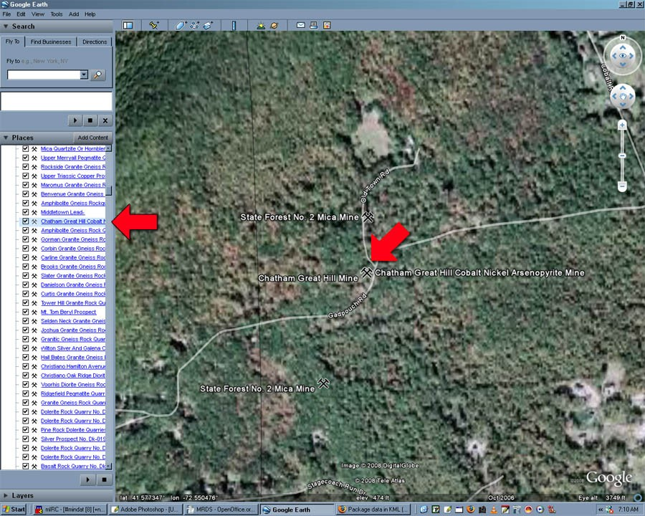
Image dataset: filtering
Datset performed poorly
Images of non-minerals
Unbalanced dataset
Cleaned and Balanced Silver Mineral Image Dataset
Total images = 7.310
Silver images = 3,655
Non-silver images = 3,655
Project Repository (GitHub)
https://github.com/bknopp71/CS5040

Slide 13
Machine learning models

Slide 14
Machine Learning Models
Used a transfer learning framework with pretrained weights
Initial hypothesis: CNN would do better
5 models trained (3 CNNs, 2 ViTs)
CNNs: TensorFlow/Keras
ViTs: Hugging Face (PyTorch)
All models implemented in Python
Vision Transformer Base with 16×16 patches (ViT-B/16)
EfficientNet-B0 (CNN architecture)
DenseNet-121 (CNN architecture)
Data-efficient Image Transformer – Small (DeiT-S)
ResNet-50 (CNN architecture)

Slide 15
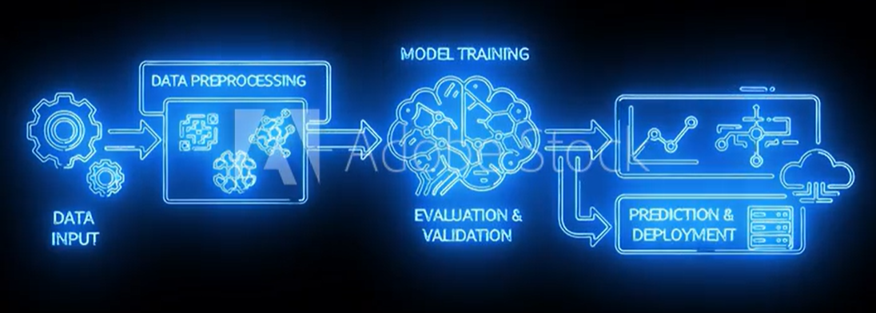
Machine Learning Models: Pipeline
Training Setup
CNNs: freeze → fine-tune
ViTs: full fine-tunig
Optimizer: AdamW | Loss: Cross-Entropy
Batch: 16–32 | Epochs: 10
Early stopping
Preprocessing
Resize: 224 × 224
Normalize (ImageNet / Hugging Face)
Split: 70% train / 20% val / 10% test
Light Data Augmentation
Training set only
Flip, rotation, zoom, contrast

Slide 16
Model Results

Slide 17
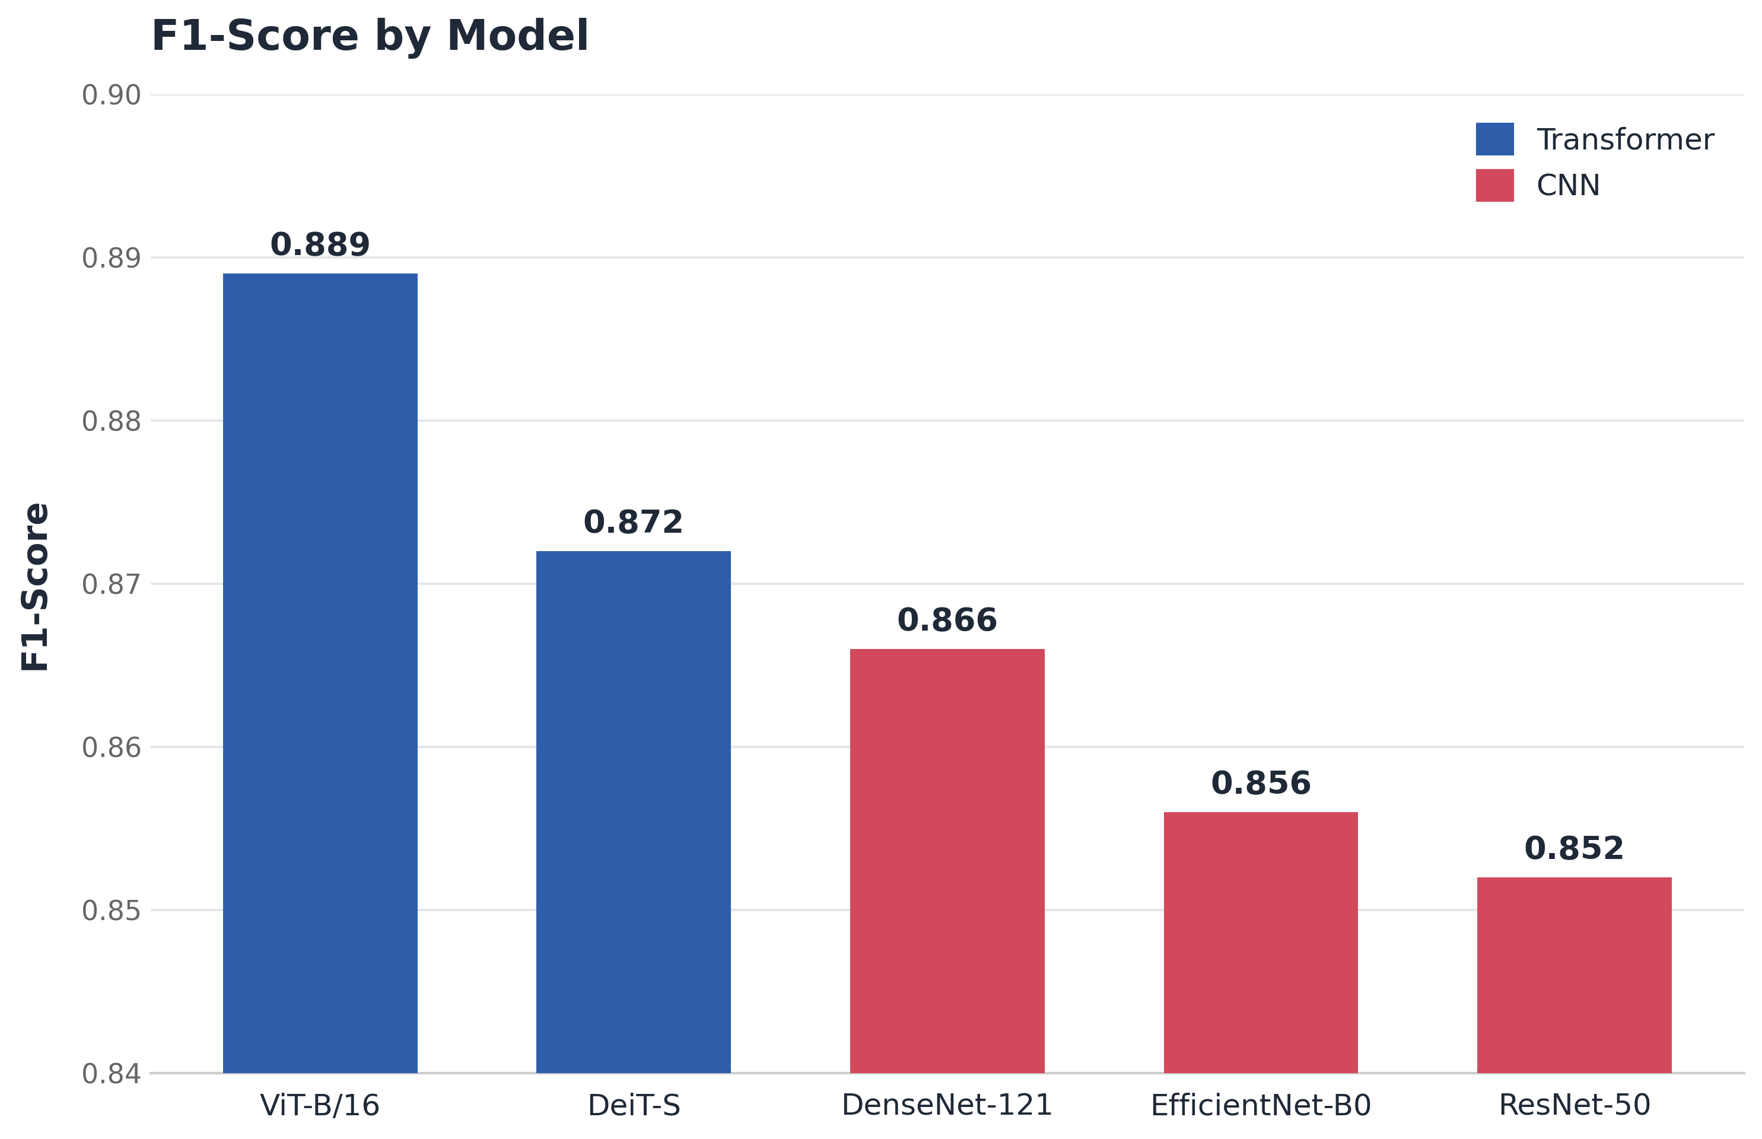
Model Results: F1-Score Comparison
F1-score evaluated at decision threshold = 0.5
ViT-B/16 achieved highest F1-score (0.889)
Transformer models outperform CNNs at baseline
CNNs show consistent but slightly lower performance
ViT-B/16 achieved the highest F1-score at threshold 0.5

Slide 18
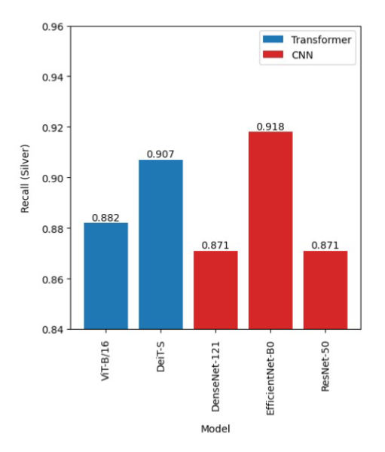
Model Results: Threshold optimization
Silver Recall evaluated using optimized decision thresholds
Threshold tuning significantly improves model performance
EfficientNet-B0 achieved highest recall (0.918) with a decision threshold tuning of (0.22)
CNNs outperform transformers in silver recall after threshold optimization
EfficientNet-B0 achieved the highest recall after threshold optimization

Slide 19
Future work

Slide 20
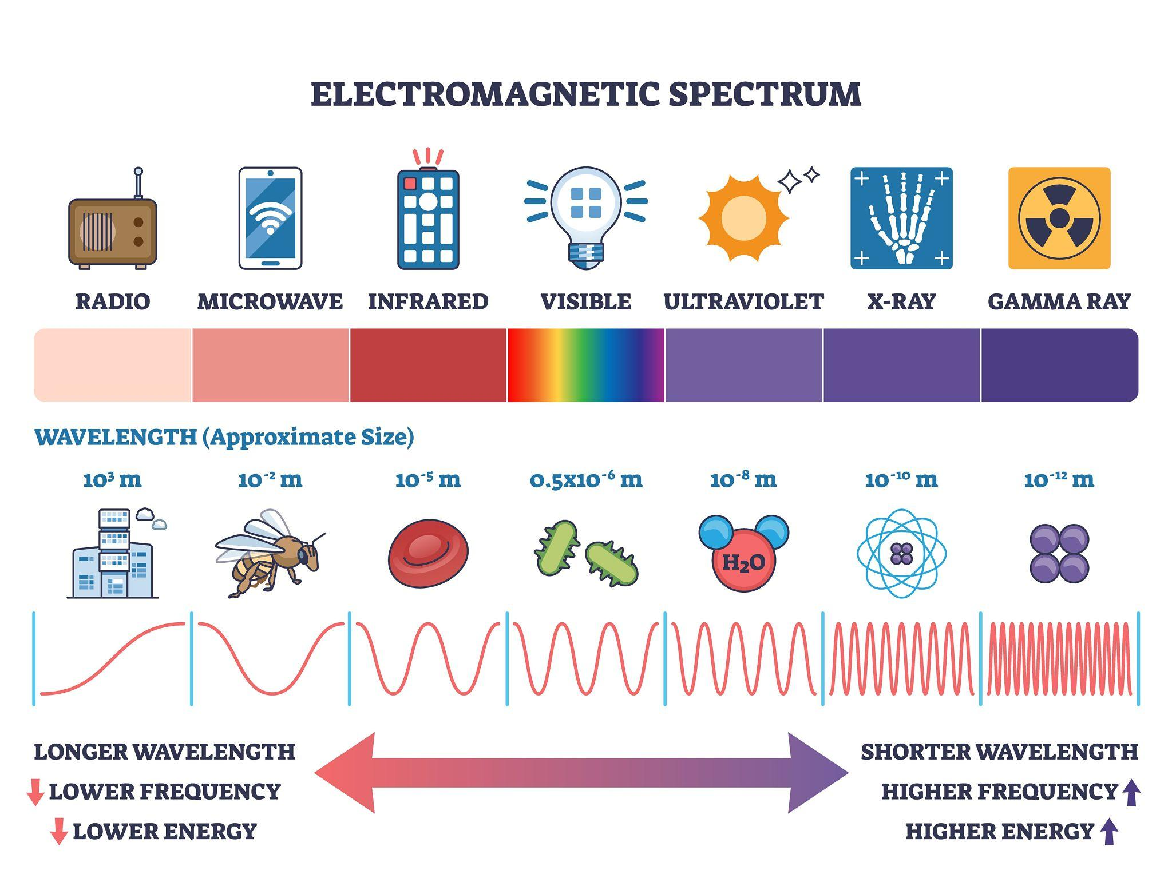
Future Work
Expand and standardize dataset
Explore multimodal and multi-sensor models
Develop region-specific datasets
Optimize for real-time field deployment
Transformers lead in overall performance, while CNNs achieve higher recall after optimization

Slide 21
Q&A

